Slide 1

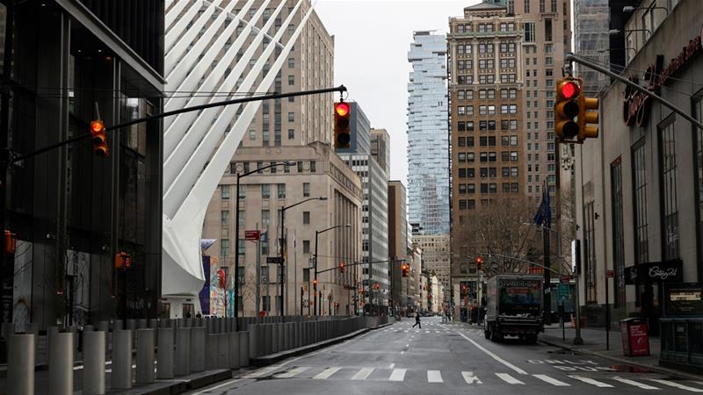
Is There A Link Between The Venues And COVID-19 Transmission?
By James Curtiss
IBM Data Capstone Project Presentation

Slide 2
Problem Statement
Identify at risk zip code areas in New York City which have a high proportion of venues where social distancing is difficult (i.e. pubs, nightclubs, beauty salons), and therefore could result in transmission of COVID-19.

Slide 3
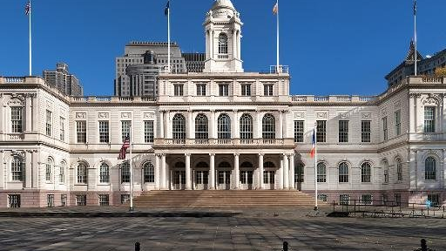
Audience
The state decision makers will be more informed about the venues in each area that will have to close if infections begin to rise once more.

Slide 4
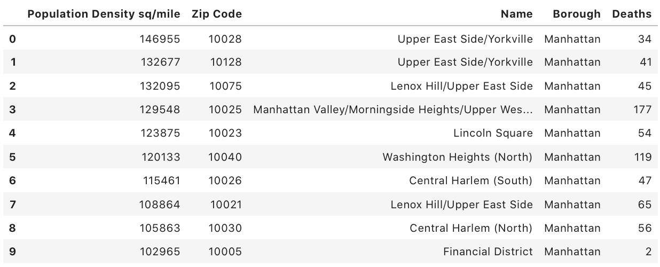
Data Cleaning
Data Sources
FourSquare API: venues of each zip code
The New York Times: number of deaths in each zip code
USA.com: population density of each zip code in New York

Slide 5
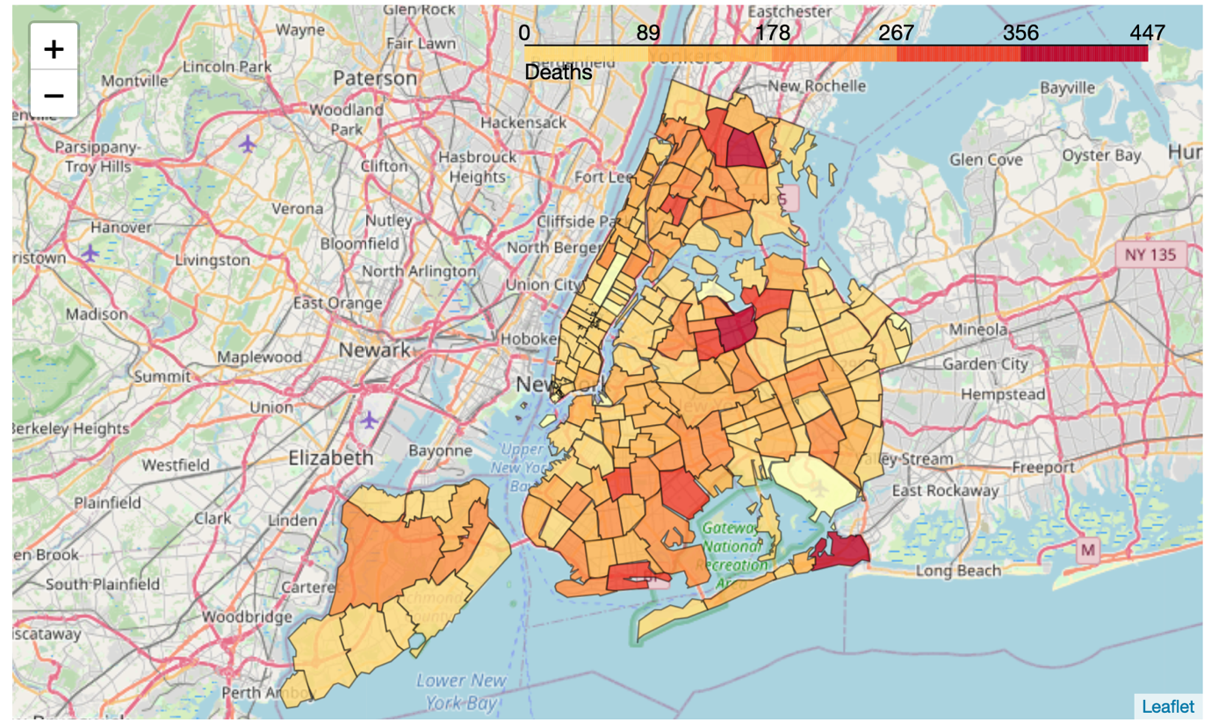
Exploratory analysis
The map displays the areas most affected by COVID-19. There are several areas of dark red (high number of deaths) surrounded by dark orange areas. The map supports the idea of clusters of COVID-19 transmitted, with one badly affected area surrounded by areas also affected by COVID-19.

Slide 6
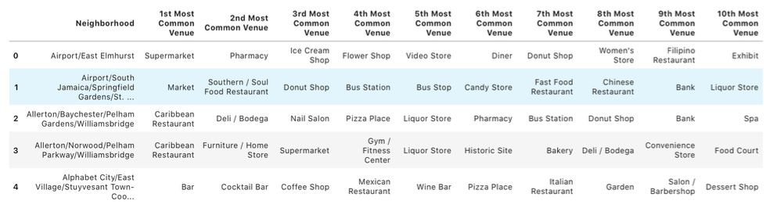
K-Means Clustering
Next, we will use the k-means clustering algorithm to cluster the neighbourhoods into similar types. This will be based off the most common venues and the population density (both key factors in determining COVID-19 transmission).

Slide 7
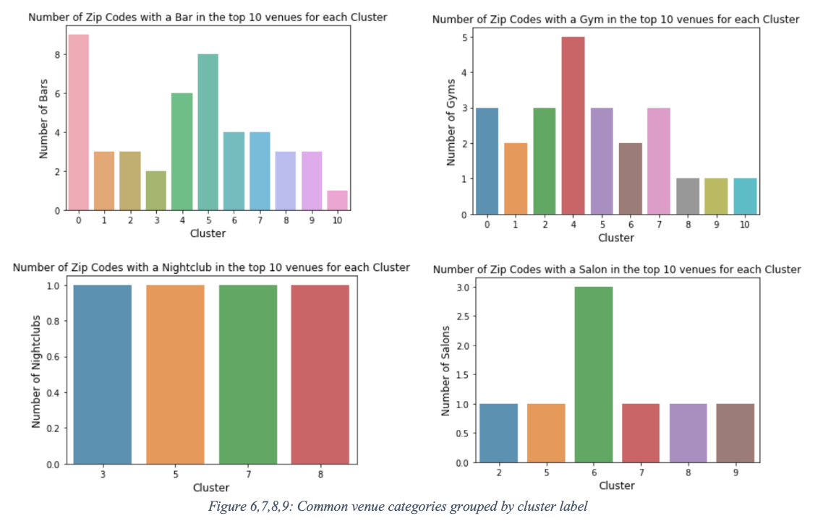
Cluster analysis
Clusters 0, 2, 4, 5 and 7: high number of neighbourhoods with common venues being a bar or gym.
Clusters 3, 5, 7 and 8: high number of neighbourhoods with nightclubs as a common venue.
Cluster 6: much higher number of neighbourhoods with common venues being a salon.

Slide 8
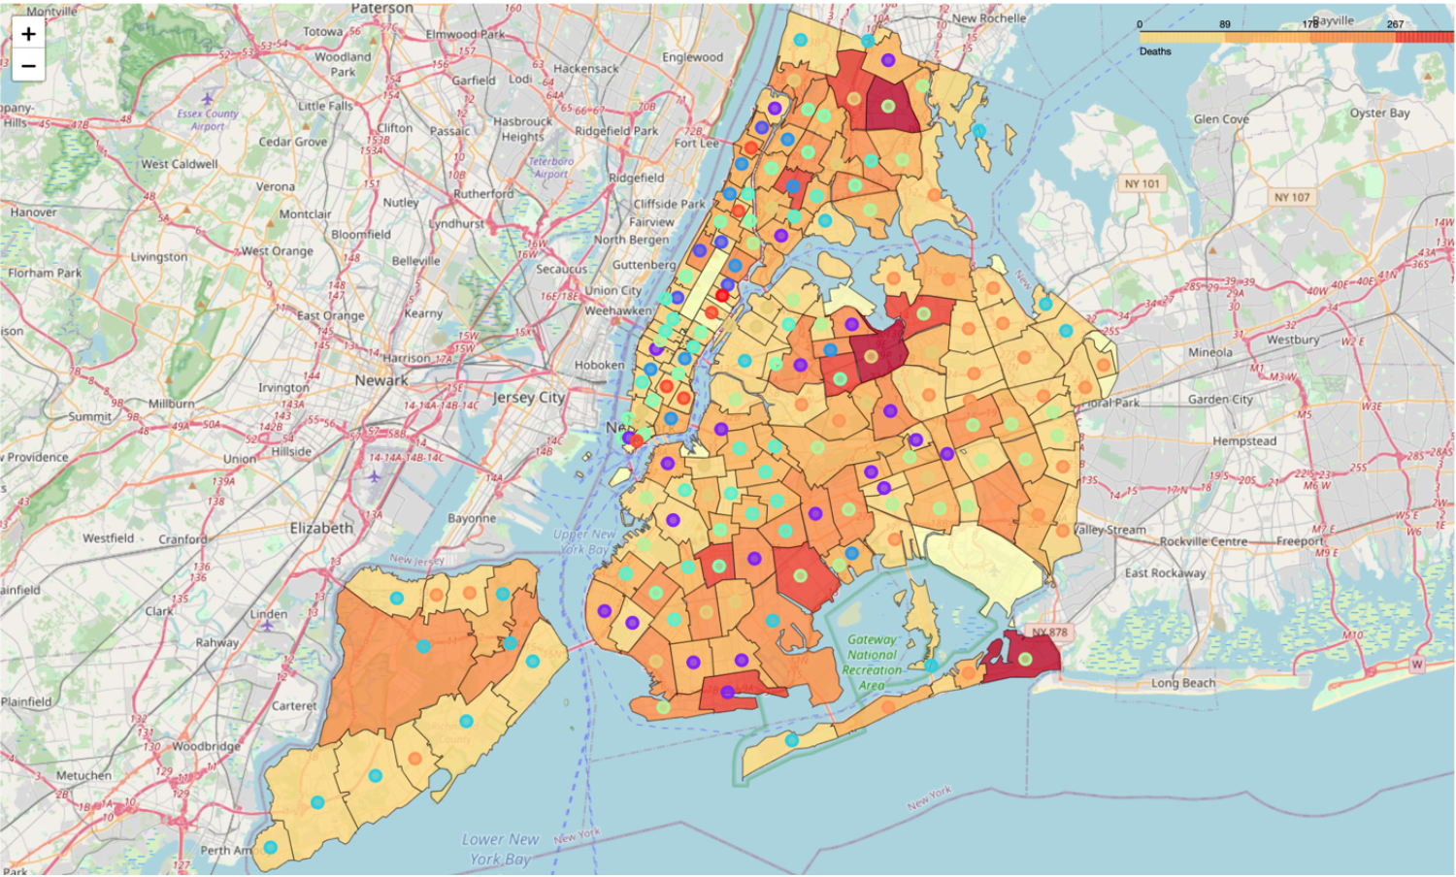
Discussion
Clusters 0, 5 and 7 are clusters that should be cautiously re-opened.
The makeup of their venues coupled with the death rate observed already make them high susceptible to further outbreaks.
On the above map, the colours for clusters 0, 5 and 7 are

Slide 9
Darker coloured areas indicating a higher number of deaths are often clustered in one of either 0, 5 or 7.
Shows correlation between the type of venue and the transmission of COVID-19.

Slide 10
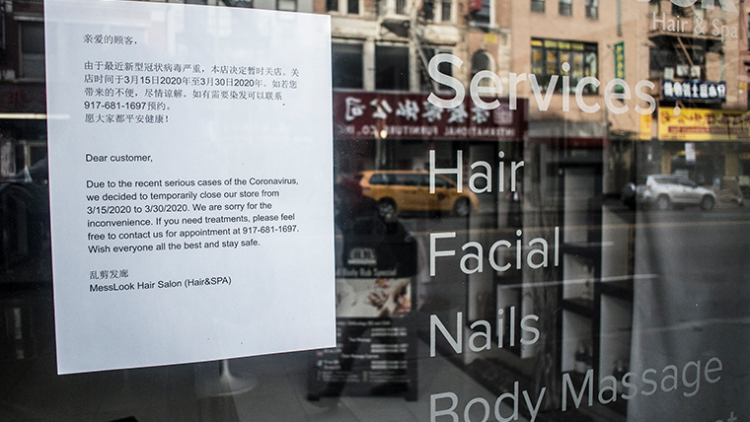
Recommendations
Clusters 0, 5 and 7 are at high risk of further waves of COVID-19 so will need to be observed for an increase in cases once New York City reopens.
Investigate economic impact these areas will suffer due to a large proportion of its shops closing.

Slide 11
References
https://edition.cnn.com/2020/07/13/health/new-york-city-coronavirus-zero-deaths/index.html
https://foursquare.com
https://www.nytimes.com/interactive/2020/nyregion/new-york-city-coronavirus-cases.html
http://www.usa.com/rank/new-york-state--population-density--zip-code-rank.htm

